Slide 1
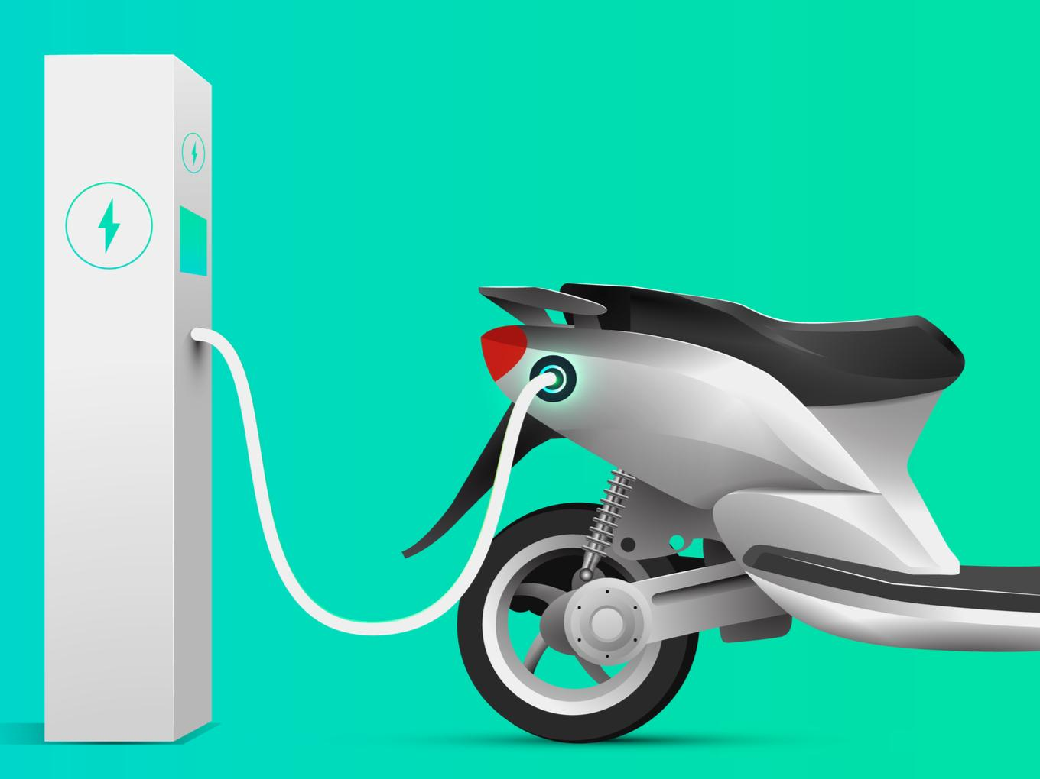
OLA ELECTRIC: MARKET LEADER yet a CASH BURNER
Ola Electric’s rising losses amid market share grow

Slide 2
Ola Electric's Market Share Growth and the Increasing Losses
The company may eventually have to reduce its discounts to achieve profitability, potentially affecting the market share.
How can Ola Electric increase profitability along with market share?

Slide 3
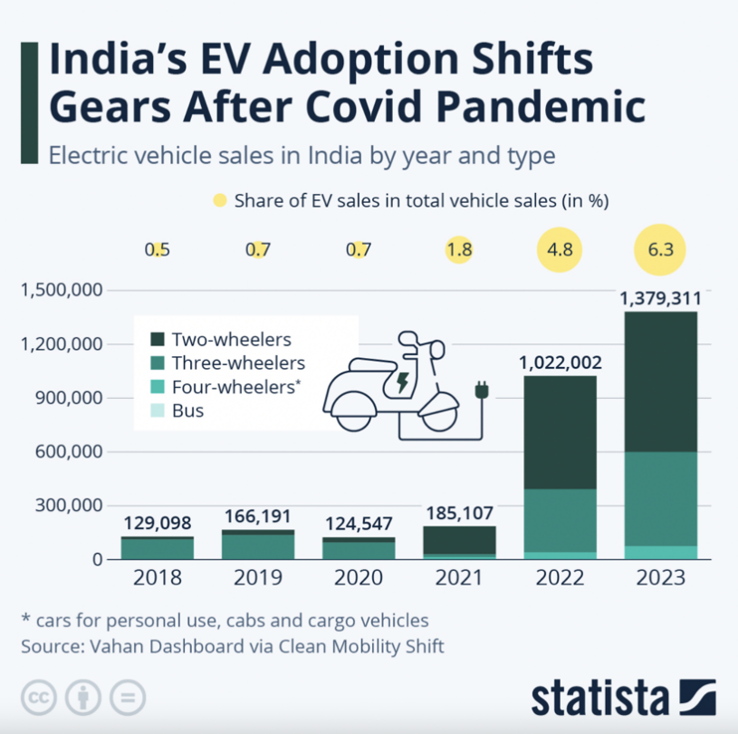
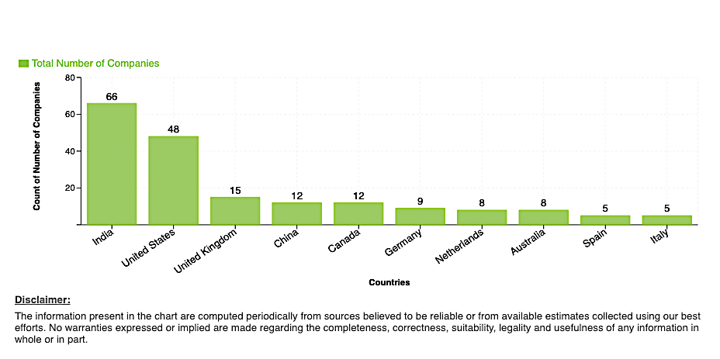
Indian Market
India Electric Two-Wheeler Market is forecast to grow at a CAGR of 40.34% during the forecast period between FY2024-FY2031 and was valued at USD 1.16 billion in FY2023.

Slide 4
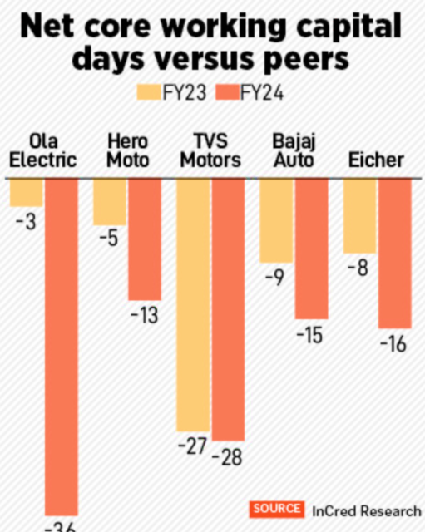

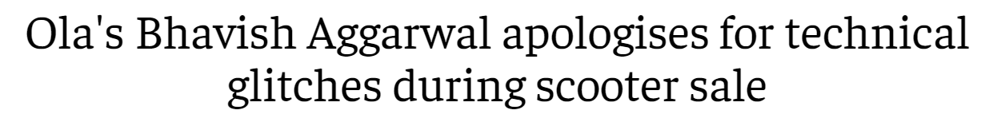
Ola Electric’s major hurdles to increase profitability
Supply Chain For Spare Parts
Highly competitive market
Ather: 42% increase in growth FY 2023
Bajaj Auto
Hero Electric
Regulatory and Infrastructure challenges
Supply Chain Disruptions
Service Network Expansion
Aggressive expansion, investment in R&D
Post Sales Service
Customer Experience
High Cash Burn Rate
Customer Education and Support
Discounts and Incentives

Slide 5
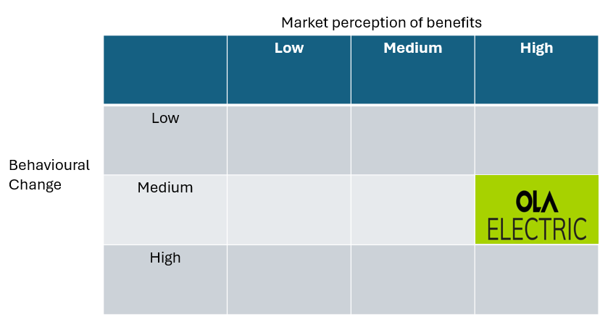
Adoption of Ola Electric
Perceived Benefits:
Building trust in product quality and addressing post-sale concerns effectively
Fuel Cost Savings
Low maintenance
Government incentives
Challenges:
Behavioural change (Refuelling)
Range anxiety
Infrastructure
Technology uncertainty

Slide 6
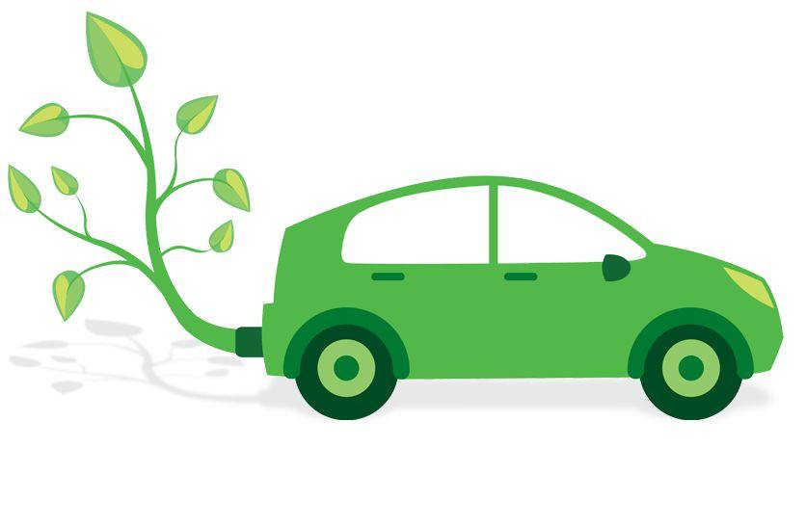





Communicating with Receptive customers
Eco-Conscious Urban Commuter
Tech-Savvy Professional
Cost-Conscious Family Driver
Loyal Traditional Car Enthusiast
Highlight environmental benefits
Financing options
Charging infrastructure
Promote advanced tech features
Detailed performance comparisons
Focus on long-term savings
Highlight safety features targeted marketing to address satisfaction gaps

Slide 7
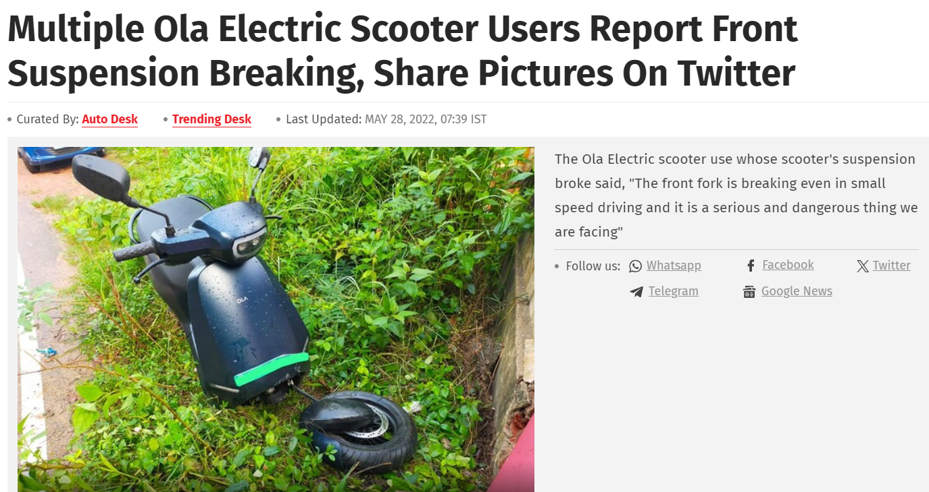
Apple way: What can Ola Learn?
Focus on Customer Experience
Intuitive and user-friendly design
Digital app and dashboard
Emotional Connection
Create compelling narratives around the brand
Like the "Think Different" campaign of Apple
Celebrate individuals and communities adopting sustainable transportation.
Communication majorly focusing on Product quality, safety and after sales service
Not just discounts, incentives, range
Community Engagement and Education

Slide 8
Apple way: What can Ola Learn?
Showrooms “Look and Feel”
Design Improvements
Minimalist and Modern
Interactive Zones
Showcase features
Visual Narratives
Hero Walls
Test Drives
Upgrade the instrument cluster across all models to a higher resolution and more interactive display.
Adopting to a design philosophy that uses clean, uninterrupted lines and simple geometric shapes
Incorporate eco-friendly materials wherever possible.

Slide 9
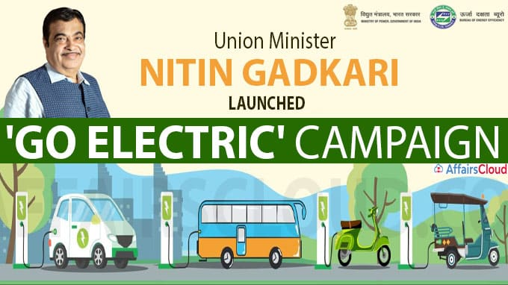
Network Expansion to Tier 2, Tier 3 and Rural areas
Educating local mechanics outside Ola ( After Sales Service) to increase accessibility
Tier 3 and Rural areas – 2-wheeler is major mode of Transportation, Tapping this market with affordable and fuel-efficient mode.
Enhanced Warranty and Maintenance Packages over discounts
Promoting electric vehicle in rural India, uplifts the life’s easing costs and commutation.

Slide 10
Communicating with Receptive customers
Problem Mode
Growth Mode
Even Kill
Overconfident
Eco-Conscious Urban Commuter
Tech-Savvy Professional
Cost-Conscious Family Driver
Loyal Traditional Car Enthusiast
Highlight environmental benefits
Financing options
Charging infrastructure
Promote advanced tech features
Detailed performance comparisons
Focus on long-term savings
Highlight safety features targeted marketing to address satisfaction gaps
Awareness campaigns on hidden costs
Free test drives
Testimonials from similar profiles

